Slide 1
Diffusion-Based Trajectory Planning for Conflicts
Woosung Kim, Jon Reasoner, and Tyler Kim

Slide 2
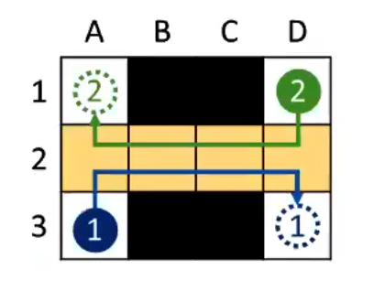
Problem: Deadlocks due to Symmetry
Symmetry serves as a major factor in deadlocks
Multiple robots struggle to socially adapt to scenarios such as entering a doorway at the same time
Image taken from Jiaoyang Li’s guest lecture

Slide 3

Motivation: Deadlocks have Consequences
Deadlocks in autonomous vehicles can be a safety hazard especially on a highway
Safety
Symmetry is still a major problem in causing deadlocks for multiple robots
Symmetry
Deadlocks prevents people from getting to where they need to be
Effectiveness

Slide 4
Problem Statement/Taxonomy
Continuous action space
Decentralized
Environment – fully observable
Agent – partially observable
No-Communication

Slide 5
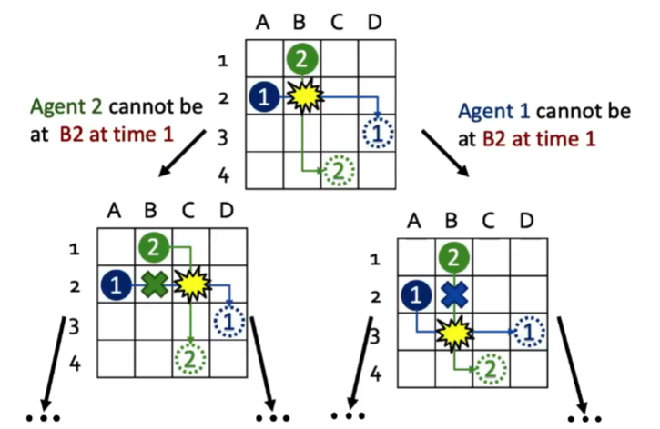
SOTA: Conflict-Based Search (CBS)
Each Agents’ trajectory is generated
If a conflict is found, additional copies (nodes) are created where an agent’s trajectory is replanned to avoid collision
Image taken from Jiaoyang Li’s guest lecture
Guni Sharon et al. “Conflict-based search for optimal multi-agent pathfinding”. In: Artificial Intelligence 219 (2015), pp. 40–66. issn: 0004-3702. doi: https://doi.org/10.1016/j.artint.2014.11.006. url: https://www.sciencedirect.com/science/article/pii/S0004370214001386.

Slide 6
SOTA: CBS Limitations
Collisions due to symmetry
Increasing computational cost
Guni Sharon et al. “Conflict-based search for optimal multi-agent pathfinding”. In: Artificial Intelligence 219 (2015), pp. 40–66. issn: 0004-3702. doi: https://doi.org/10.1016/j.artint.2014.11.006. url: https://www.sciencedirect.com/science/article/pii/S0004370214001386.

Slide 7
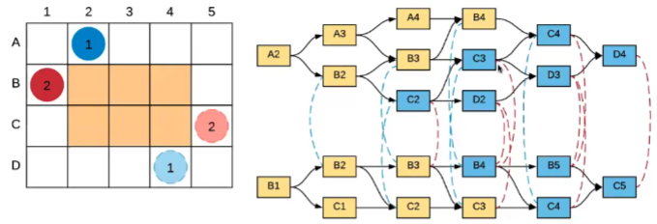
SOTA: CBS Symmetry Constraint
Li et al – adding symmetry breaking constraints
Proposed an MDD data structure
Image taken from Jiaoyang Li’s guest lecture
Hang Ma, T. K. Satish Kumar, and Sven Koenig. “Multi-Agent Path Finding with Delay Probabilities”. In: CoRR abs/1612.05309 (2016). arXiv: 1612.05309. url: http://arxiv.org/abs/1612.05309

Slide 8
SOTA: CBS Symmetry Constraint Limitations
More scalable than vanilla CBS but not completely
Adding admissible heuristics with symmetry constraint increases scalability but yields suboptimal results
Severe tradeoff between optimality and scalability
Jiaoyang Li et al. “Improved Heuristics for Multi-Agent Path Finding with Conflict-Based Search”. In: Proceedings of the Twenty-Eighth International Joint Conference on Artificial Intelligence, IJCAI-19. International Joint Conferences on Artificial Intelligence Organization, July 2019, pp. 442–449. doi: 10.24963/ijcai.2019/63. url: https://doi.org/10.24963/ijcai.2019/63.

Slide 9
Approach
Cool overview image that shows our process
Steps:
Thing 1
Thing 2
Thing 3

Slide 10
Evaluating Success
Cool images and videos

Slide 11
Proof of Concept
Final thoughts about life in general
Future Work:
Thing 1
Thing 2
Thing 3

Slide 12
QUESTIONS?

